Slide 1
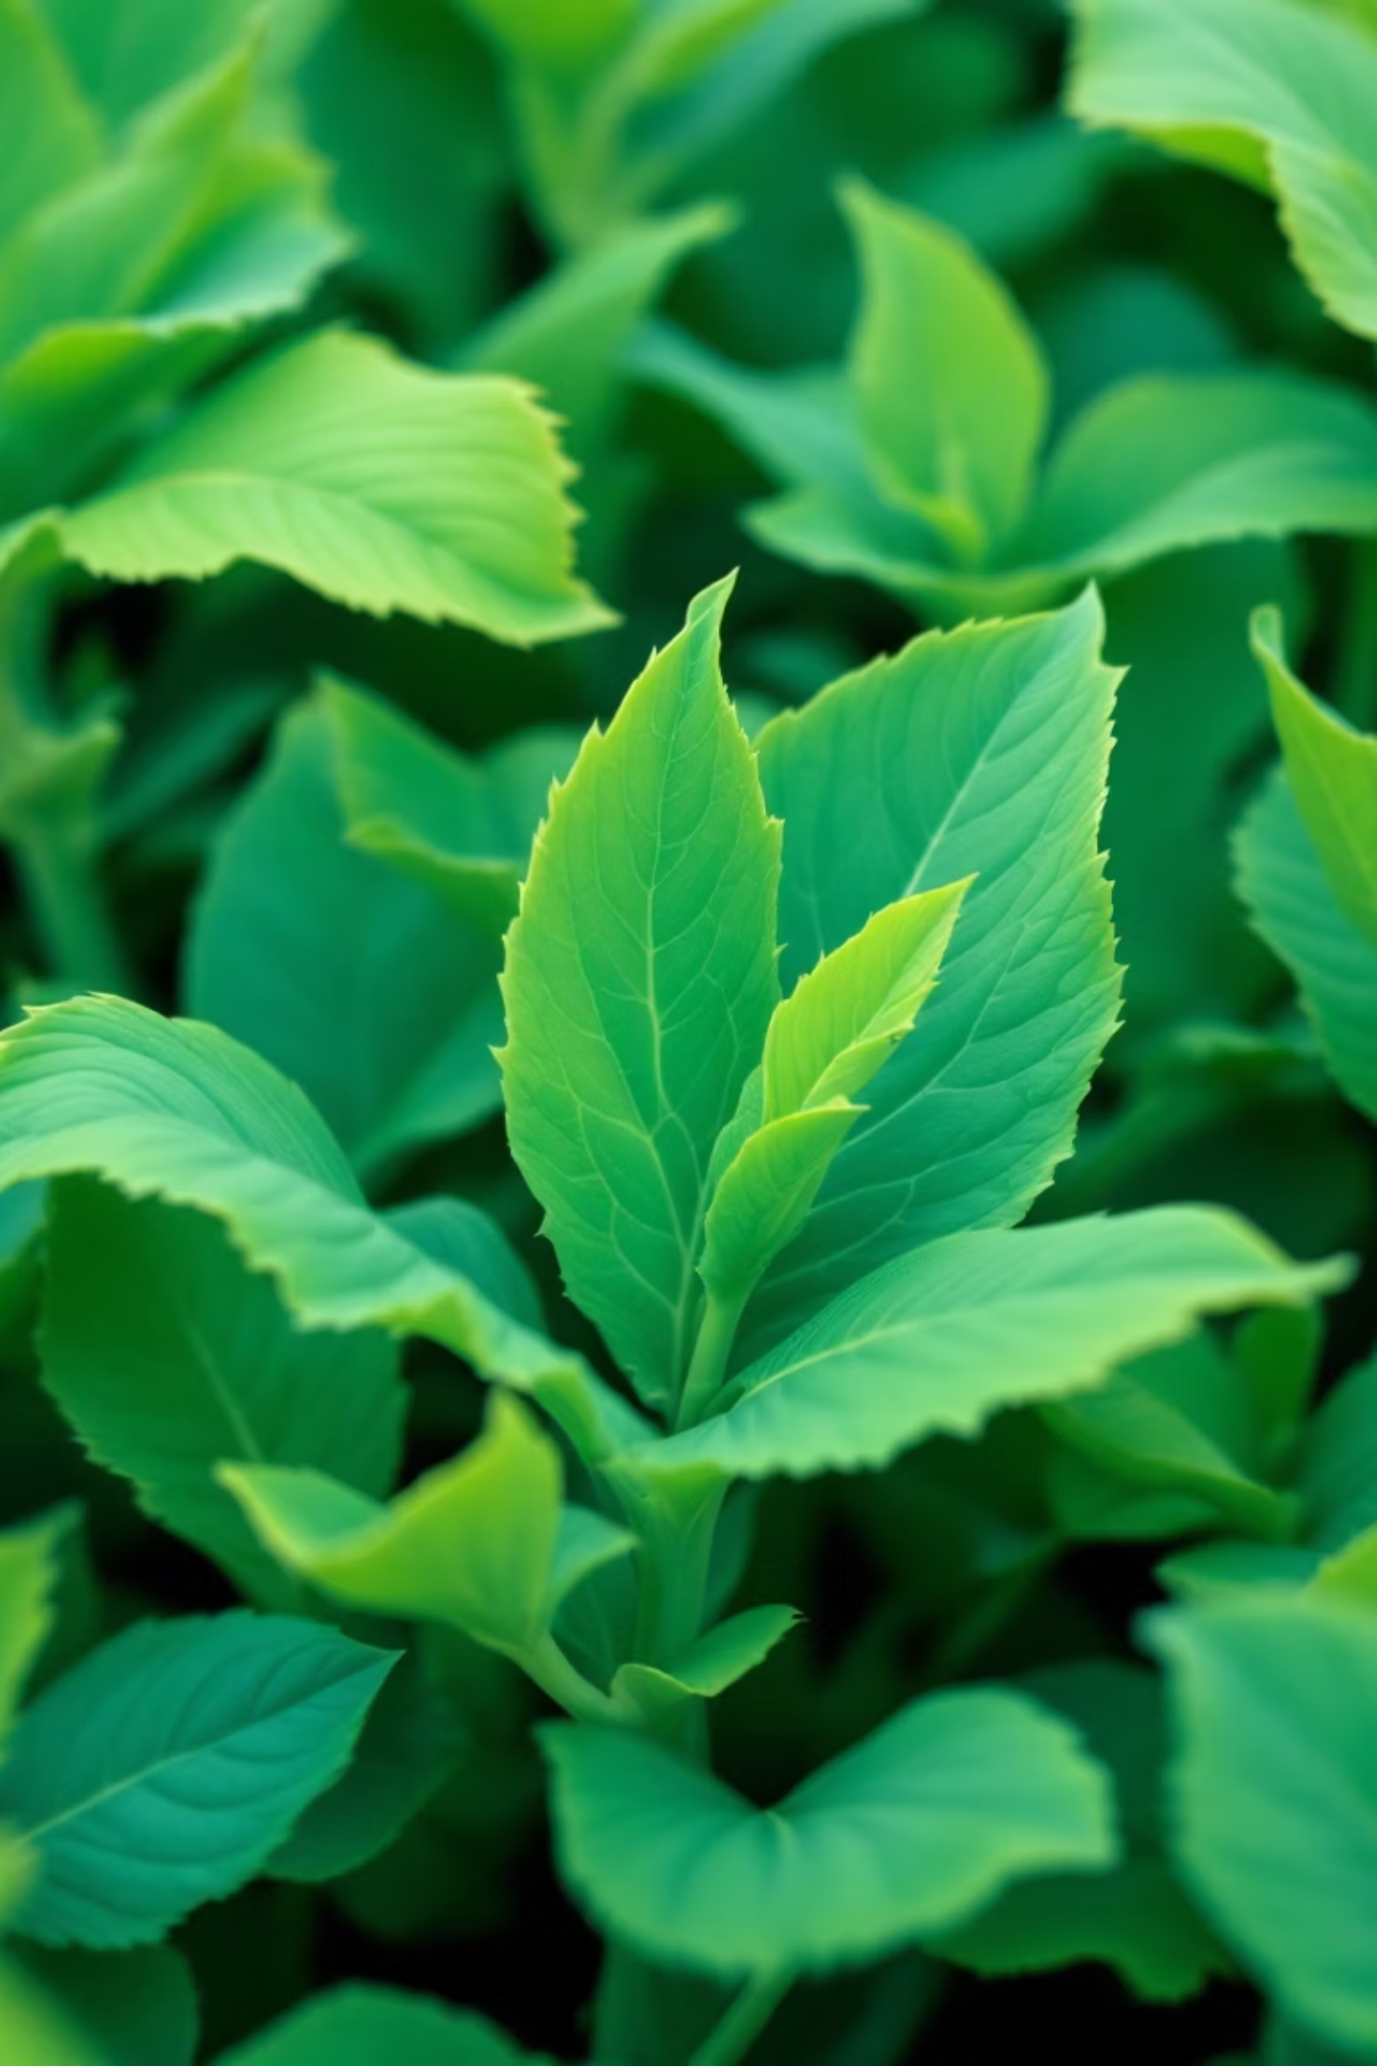
🌾 AgroBot – AI-Powered Multilingual Plant Doctor
Author: Yagnasree Rampa

Slide 2
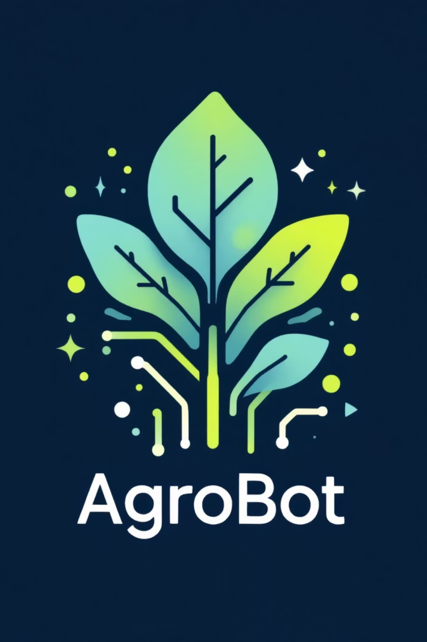
AgroBot – AI-Powered Multilingual Plant Doctor
Smart Agricultural Assistant for Plant Disease Detection
Developed by: Yagnasree Rampa
Tools Used: Streamlit, Python, Google Translator, JSON
1

Slide 3
Introduction
AgroBot is an intelligent, AI-driven plant disease detection system.
Helps farmers identify crop diseases from leaf images or text descriptions.
Provides treatment suggestions in the farmer’s preferred language.
Designed to support farmers with limited technical knowledge.
2

Slide 4
Key Features
Plant Disease Recognition
Chatbot for Farmers
Multilingual Support
Understands user queries (e.g., “yellow leaves”)
Supports multiple Indian languages via Google Translator API
Upload leaf images → detects disease using trained ML model
Suggests likely diseases and remedies
Admin Dashboard
Secure Login System
Manage users, predictions, and delete records easily
User authentication using bcrypt hashing
3

Slide 5
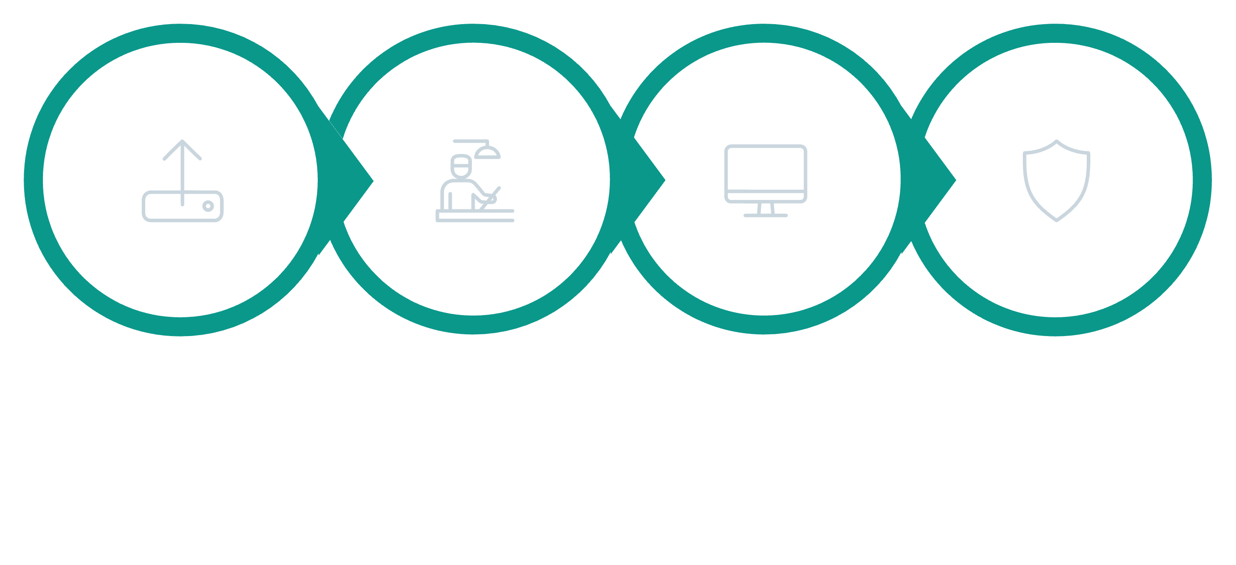




System Architecture / Workflow
User Input
Processing
Output
Admin
01
02
User Interaction:
Processing:
Upload image or type symptoms → AgroBot interface
For image input → passes through ML model
03
For text input → uses similarity matching (difflib) on dataset
04
Output:
Admin Access:
Displays disease name, symptoms, and solution
View or delete user data and predictions
Translates responses into user’s chosen language
4

Slide 6
Tech Stack
Layer
Tools & Technologies
Frontend
Streamlit
Backend
Python
Database
JSON (user & prediction storage)
Authentication
bcrypt
Translation
Googletrans API
Libraries
Pillow (PIL), difflib
Optional AI Model
TensorFlow / Keras (for image classification)
4

Slide 7
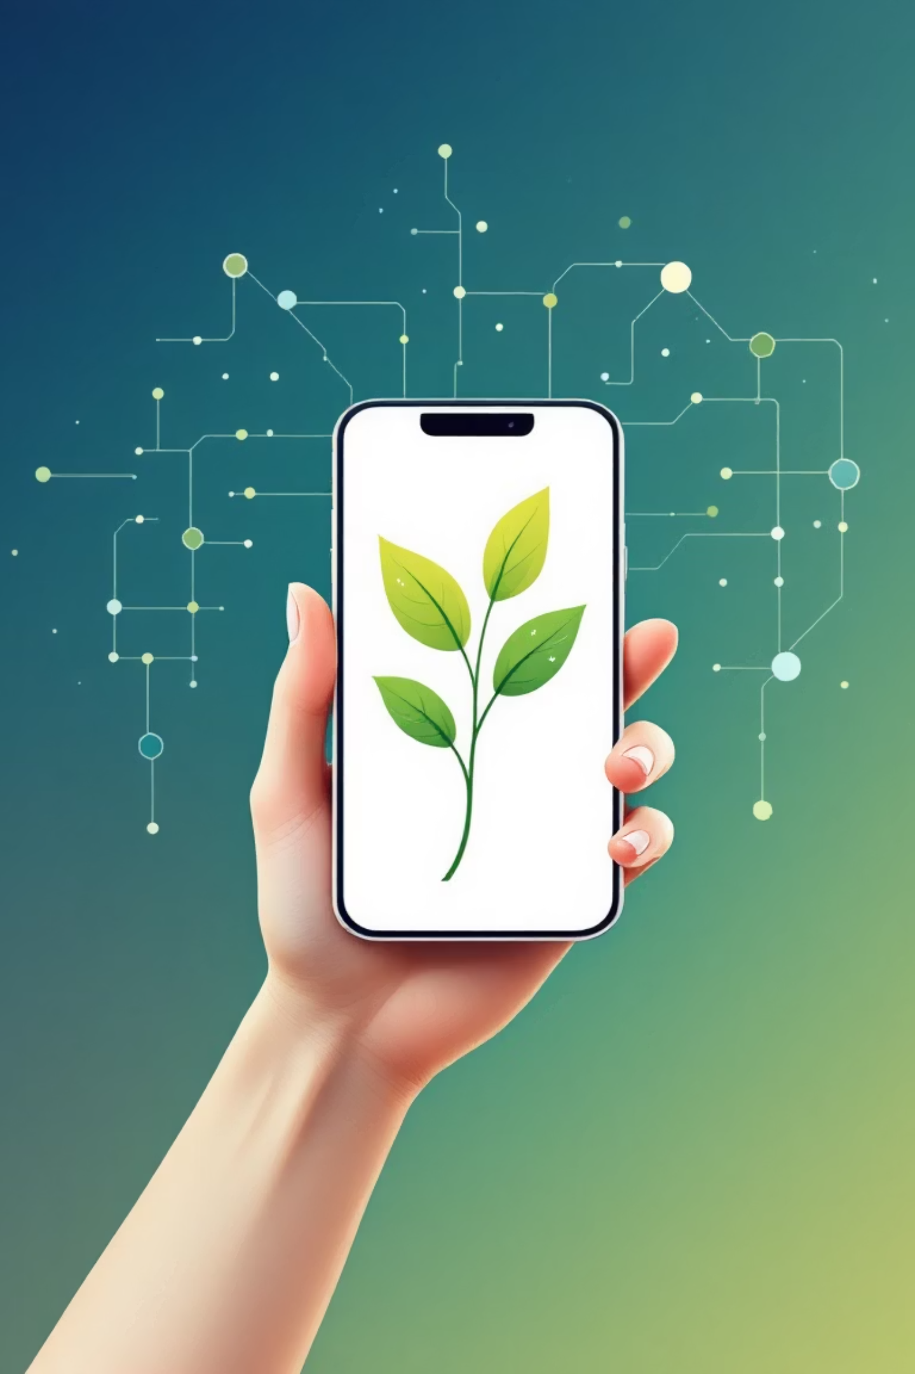
Admin & User Features
👨‍🌾 User Panel:
👩‍💼 Admin Panel:
Register, login, and detect plant diseases
Access all user data
Delete users and predictions
View past predictions
Monitor system activity
Receive solutions in preferred language
5

Slide 8

Future Enhancements
🚀 Planned Improvements:
Integration with real-time AI disease detection API
Voice-based chatbot (speech-to-text and text-to-speech)
Cloud-based database (Firebase / MongoDB)
Mobile-friendly responsive design
Weather-based disease prediction suggestions
6

Slide 9




Conclusion
AgroBot bridges technology and farming through AI.
Helps farmers detect plant diseases instantly.
Supports regional languages for wider accessibility.
A step toward smart, sustainable agriculture.
7

